Slide 1
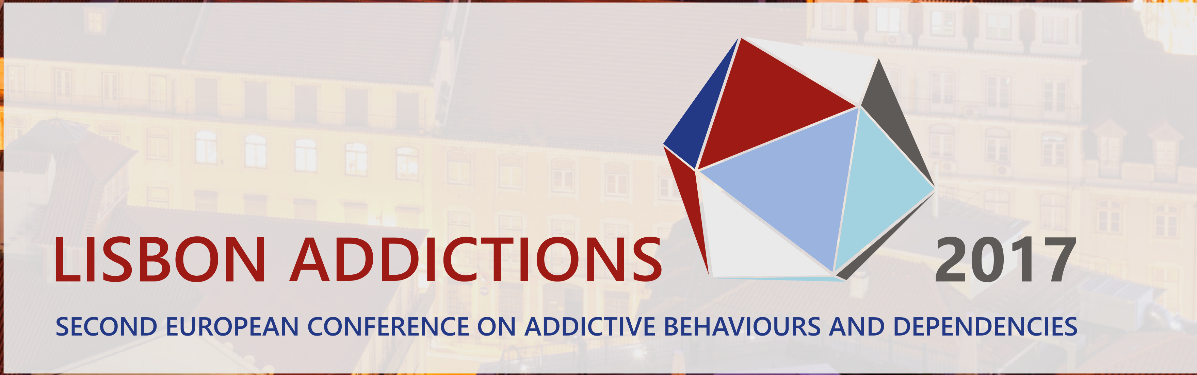
Anabolic steroids: a global public health perspective
Jim McVeigh
Director
Public Health Institute

Slide 2
Datasources
Surveillance data from NSPs (1991 - 2016);
UK survey data (2013- 2016) 1549 IPED users: demographics, drug use histories, health profiles, risk behaviour and motivations for use;
HIV, hepatitis B and hepatitis C prevalence data from PHE surveillance system of people who inject drugs (from1992 - 2016) and two bespoke IPED injector surveys;
Global Drug Survey 2015

Slide 3
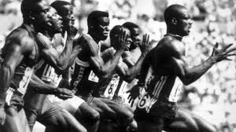

Slide 4
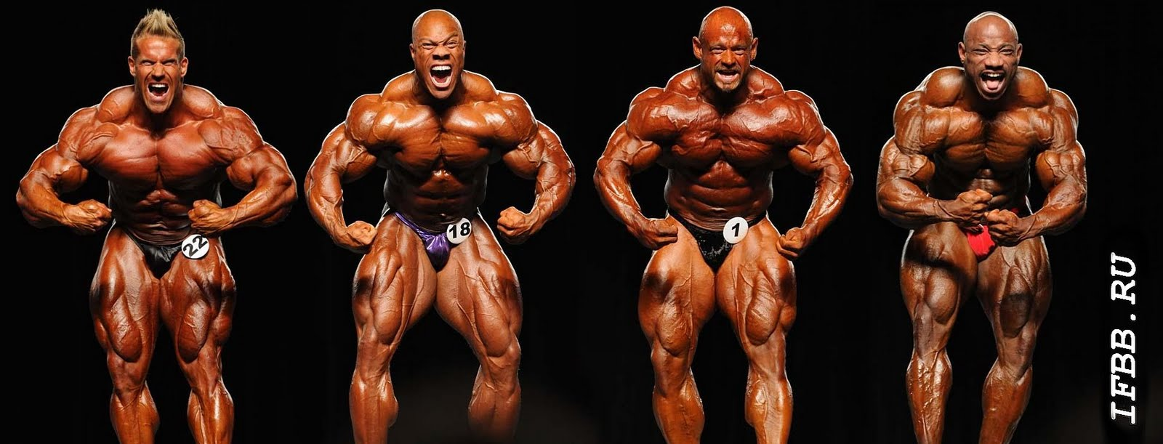
Reproduced from www.ifbb.ru

Slide 5
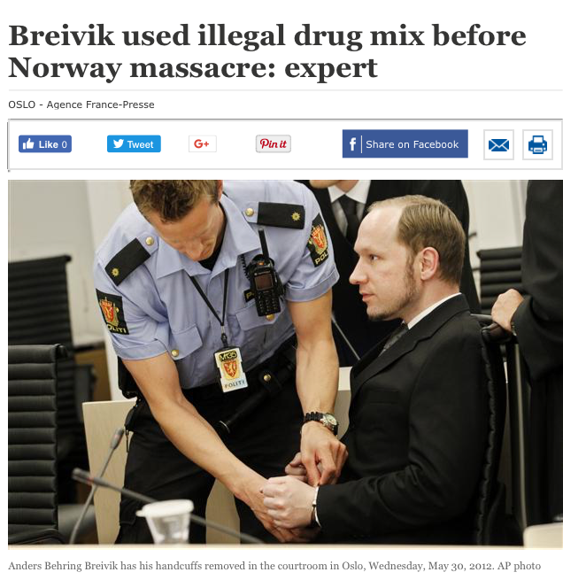

Slide 6
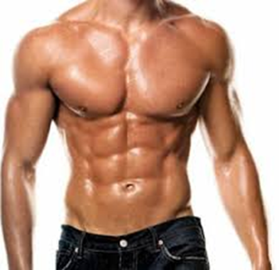

Slide 7
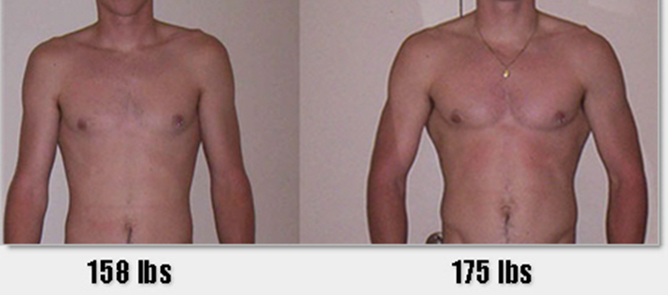
In reality…

Slide 8
Anabolic steroids definition
Mimic the effects of testosterone
Testosterone - anabolic & androgenic
Anabolic - growth & development of tissue
Androgenic - secondary male sexual characteristics

Slide 9
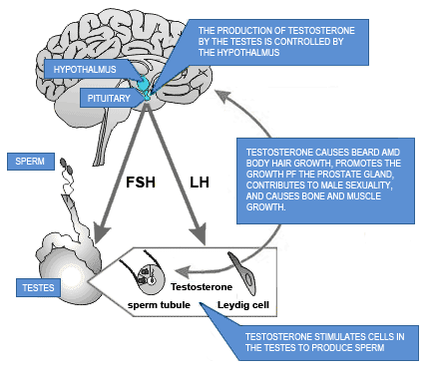
Testosterone production

Slide 10
PANIC!
PANIC!

Slide 11
Testosterone
Berthold 1849

Slide 12
Anabolic steroid use in last year/ever
“Have you ever taken anabolic steroids (steroids) (not prescribed by a doctor) even if it was a long time ago?”
Adults ever 356,000 (302,000 – 411,000)
Adults last year 61,000 (38,000 – 83,000)
YP last year 23,000 (5,000 – 40,000)

Slide 13
‘All’ & ‘new’ clients attending agency based NSPs in Liverpool City Region (1991 to 2011)

Slide 14
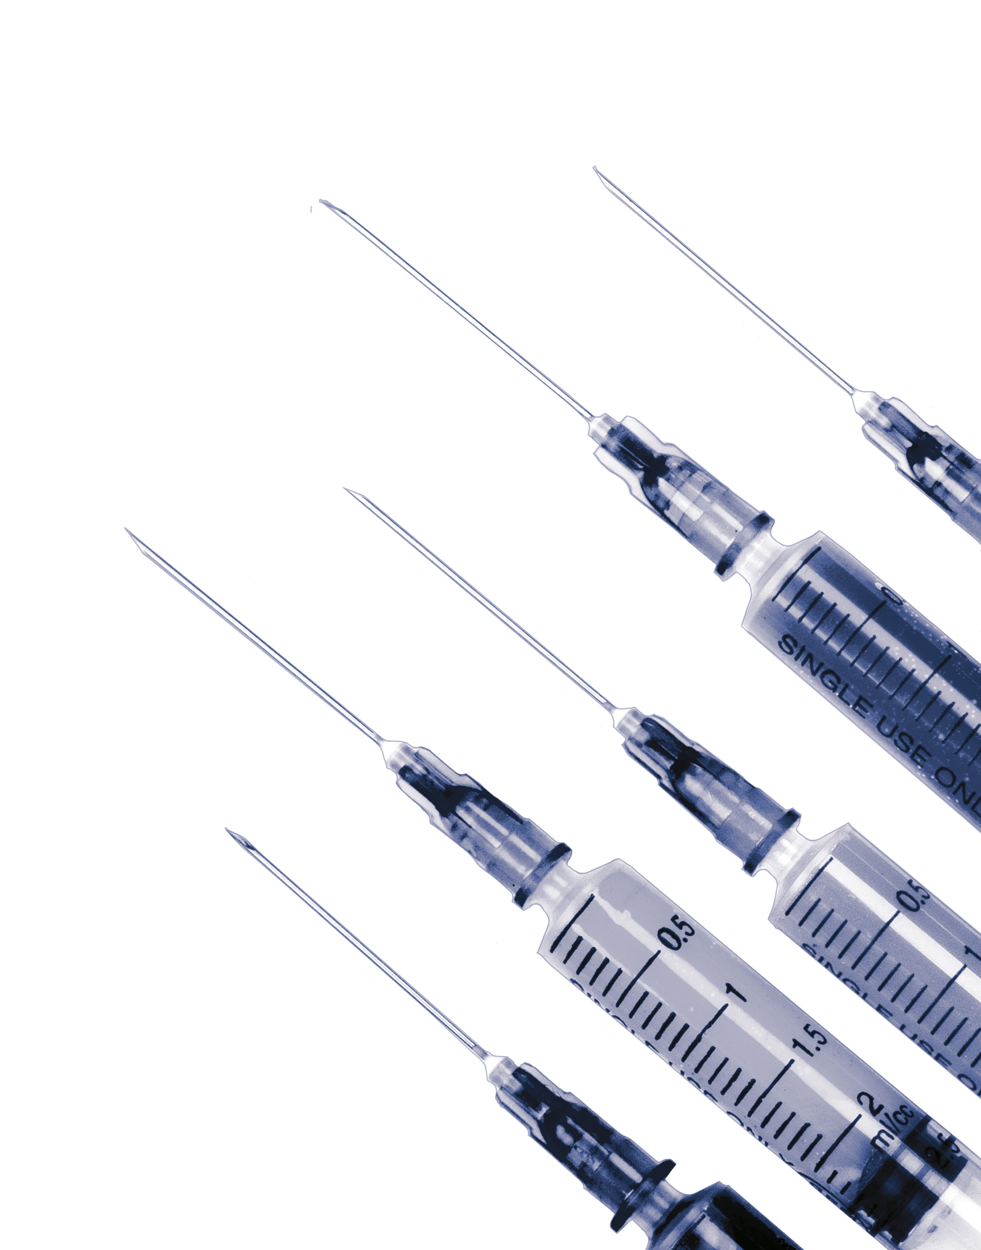
NSP clients using anabolic steroids in Northern England
Middlesbrough | 67%
Kirklees | 60%
Sheffield | 62%
Newcastle | 52%
Sunderland | 60%
Bradford | 41%
Halton | 86%
Liverpool | 83%
Sefton | 43%
St Helens | 34%
Warrington | 86%
Wirral | 77%
Manchester | 60%
Bolton | 52%
(Kimergard & McVeigh, 2014)

Slide 15
Anabolic steroid users accessing NSPs in Cheshire and Merseyside, UK (1995 and 2015)
(McVeigh & Begley, 2017)

Slide 16
Anabolic steroid users attending NSPs in Liverpool City Region (1995 and 2015)
 | 1995 | 2015
Number of anabolic steroid NSP clients | 553 | 2446
Proportion of NSP clients | 17% | 55%
Syringes provided to steroid users | 14,293 | 139,956
Mean syringes per steroid user | 26 | 57
(McVeigh & Begley, 2017)

Slide 17
Harms associated with anabolic steroid use

Slide 18

Adverse Health Consequences of Performance Enhancing Drugs
An Endocrine Society Scientific Statement
Adverse effects on several organ/systems in particular:
Cardiovascular effects
Haematologic effects
Psychiatric and neuropsychologic effects
Hormonal and metabolic effects
Variety of less frequent effects on various other bodily tissues.
Pope et al, 2013

Slide 19
Bilateral deltoid abscesses pre-operative clinical appearance
Marquis & Maffulli, 2006

Slide 20
Intra-operative drainage
Marquis & Maffulli, 2006

Slide 21
Unlinked Anonymous Monitoring Survey of People Who Inject image and performance enhancing drugs
 | 2010/11 | 2012/13
Anti-HIV Prevalence | 1.5% (400) | 2.0% (249)
Anti-HBc Prevalence | 8.7% (400) | 2.8% (249)
Anti-HCV Prevalence | 5.4% (400) | 3.6% (249)
Level of sharing (direct & indirect) | 8.9% (392) | 13% (243)
Hepatitis B vaccine uptake | 24% (375) | 40% (246)
Symptom of injection site infection | 6.9% (389) | 16% (238)
Ever been in prison | 17% (377) | 24% (247)
Hope, McVeigh et al, 2014

Slide 22

One in three of people using IPEDs who use NSP distribute equipment to others
Notes:
1 in 3 (33%) report usually collecting equipment for others = 163

Slide 23
Estimated extend of secondary distribution
There were 564 participants in the sample.
160 collected for others.
Minimum:
160 participants 667 others
Range of users which may not be engaging with NSP from our sample
Mid-point:
160 participants 1,040 others
Glass R et al Secondary distribution of injecting equipment obtained from needle and syringe programmes by people injecting image and performance enhancing drugs: England & Wales, 2012-15.

Slide 24
Injection of psychoactive drugs
Hope et al. Drug and Alcohol Dependence 2017;179 :83-86

Slide 25
Prevalence of antibodies to hepatitis C
Overall one in twenty had antibodies

Slide 26
Awareness of having had hepatitis C

Slide 27
Global phenomenon

Slide 28
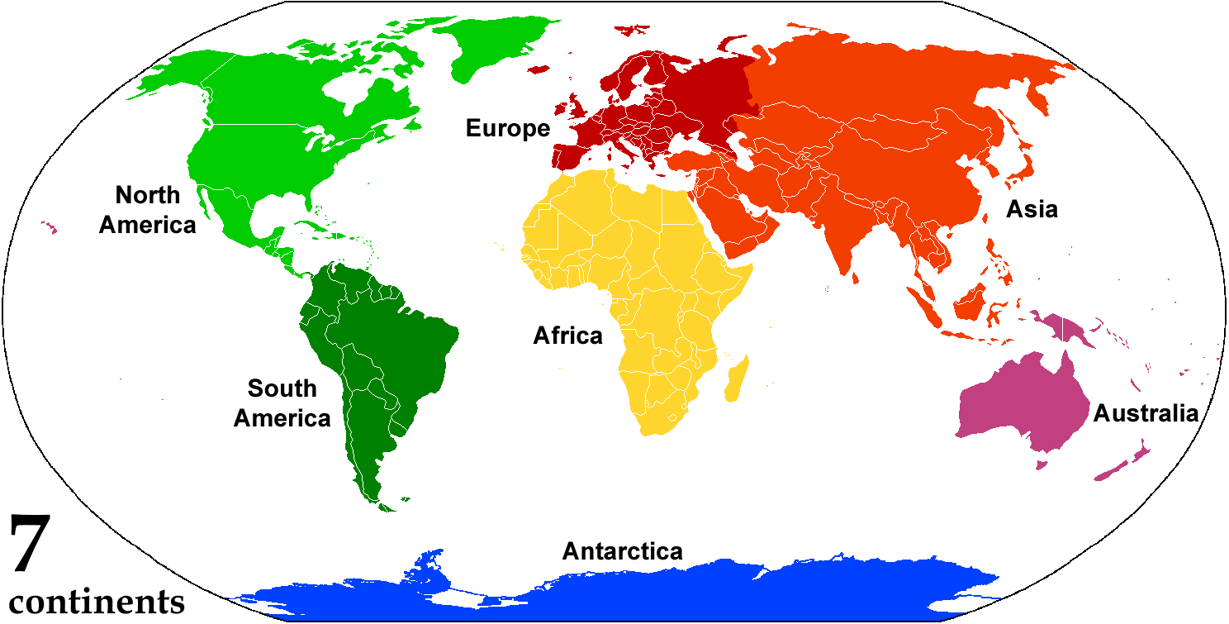
Global Drug Survey 2015 (89,509 responses)
525
96
104
250
993 male anabolic steroid users
Other 17
Zahnow et al (2017)

Slide 29
Region of residence: AAS users as proportion of GDS participants
Characteristics | Total males | Ever used | % of total males ever used | Used in the last 12 months | % of total male used in last 12 months
Region
Europe | 47,424 | 525 | (1.10) | 158 | (0.33)
North America | 3,038 | 96 | (3.06) | 27 | (0.86)
South Americas | 3,133 | 250 | (7.39) | 84 | (2.48)
Oceania | 4,080 | 104 | (2.49) | 38 | (0.91)
Other | 537 | 17 | (3.07) | 8 | (1.44)
Total | 58,212 | 993 | (1.68) | 315 | (0.53)
Zahnow et al (2017)

Slide 30
Global Drug Survey – 993 steroid users
Drug | Used in last 12 months | Lifetime use
Cannabis | 63.1 | 87.8
Other drugs * | 44.6 | 71.4
Ecstasy | 41.8 | 61.3
Cocaine | 38.7 | 61.3
Amphetamines | 20.6 | 49.1
LSD | 18.1 | 41.1
Benzodiazepines | 28.2 | 34.8
NPS | 14.0 | 31.0
Opiates | 15.3 | 30.0
Zahnow et al (2017)
* Including magic mushrooms, poppers, nitrous, ketamine and GHB

Slide 31
References
Hope, V. D., McVeigh, J., Smith, J., Glass, R., Njoroge, J., Tanner, C., . . . Desai, M. (2017). Low levels of hepatitis C diagnosis and testing uptake among people who inject image and performance enhancing drugs in England and Wales, 2012-15. Drug and Alcohol Dependence, 179, 83-86.
McVeigh, J., & Begley, E. (2017). Anabolic steroids in the UK: an increasing issue for public health. Drugs: Education, Prevention and Policy, 24.:3, 278-285
Hope, V. D., McVeigh, J., Marongiu, A., Evans-Brown, M., Smith, J., Kimergard, A., . . . Bellis, M. A. (2013). Prevalence of, and risk factors for, HIV, hepatitis B and C infections among men who inject image and performance enhancing drugs: a cross-sectional study. BMJ OPEN, 3(9), 11
McVeigh, J., Beynon, C., & Bellis, M. A. (2003). New challenges for agency based syringe exchange schemes: Analysis of 11 years of data (1991-2001) in Merseyside and Cheshire, United Kingdom. International Journal of Drug Policy, 14(5-6), 399-405.
Zahnow, R., McVeigh, J., Ferris, J., & Winstock, A. (2017). Adverse effects, health service engagement, and service satisfaction among anabolic androgenic steroid users. Contemporary Drug Problems 44(1):69-83 01
Hope, V. D., Harris, R., McVeigh, J., Cullen, K. J., Smith, J., Parry, J. V., . . . Ncube, F. (2016). Risk of HIV and Hepatitis B and C Over Time Among Men Who Inject Image and Performance Enhancing Drugs in England and Wales: Results From Cross-Sectional Prevalence Surveys, 1992-2013. JAIDS, 71(3), 331-337
Hope, V. D., McVeigh, J., Marongiu, A., Evans-Brown, M., Smith, J., Kimergard, A., . . . Ncube, F. (2015). Injection site infections and injuries in men who inject image- and performance-enhancing drugs: prevalence, risks factors, and healthcare seeking. Epidemiology and Infection, 143(1), 132-140.
McVeigh, J., bates, G., & chandler, M. (2015). Steroids and Image Enhancing Drugs 2014 Survey Results. http://www.cph.org.uk/wp-content/uploads/2015/07/SIEDs-report-GB-JL-10-7-15-Final.pdf
Bates, G., & McVeigh, J. (2016). Image and Performance Enhancing Drugs 2015 Survey Results. Liverpool: Liverpool John Moores University. http://www.cph.org.uk/wp-content/uploads/2016/07/IPEDs-2015-survey_final1.pdf
Kimergard, A., & McVeigh, J. (2014). Environments, risk and health harms: a qualitative investigation into the illicit use of anabolic steroids among people using harm reduction services in the UK. BMJ Open, 4(6),

Slide 32
Jim McVeigh
Director
Public Health Institute
Liverpool John Moores University
0151 231 4512
j.mcveigh@ljmu.ac.uk

