Slide 1
Measuring problematic use in the general population
Conception, use and future of the Cannabis abuse screening test (CAST)
Stéphane Legleye
CESP, Inserm, Villejuif, France

Slide 2
The rationale for a broader definition of cannabis use than ICD or DSM diagnoses
Cannabis use is widespread and mostly used for recreational purpose
Only a small proportion of users use cannabis to cope for everyday life difficulties and will ever need a treatment or present clear dependence symptoms
➔ Public health interest in defining a « problematic cannabis use » that relates clearly to negative consequences but that is broader than dependence

Slide 3
Problematic cannabis use? (1)
To monitor the cannabis use problem in general population surveys
To screen before more in-depth diagnoses in clinical settings
Pragmatic definition by the EMCDDA
consumption patterns “...leading to negative consequences on a social or health level, both for the individual user and for the larger community” (Beck & Legleye, 2008, p. 31)

Slide 4
Problematic cannabis use? (2)
Some scholars suggest to simply measure frequency and quantity of use, as is often done in alcohol research (e.g. Newton et al., 2011; Rehm et al., 2013)
Such instruments are not specific enough and can lead to a high rate of false positive cases (cf. Asbridge et al., 2014)
  Though this might be reasonable in clinical contexts, a screening instrument for general population surveys needs to show high specificity
  Measuring quantity with cannabis is very challenging !

Slide 5
Problematic cannabis use? (3)
Structured diagnostic interviews?
Too long for general population surveys
Threat of high non-response rates
  Litteracy problems
  Rare outcomes that are irrelevant for most respondents
Focus on current clinical diagnoses that exclude at risk users
Broader spectrum of problems and patterns of use
Short instruments
Validations needed

Slide 6
Short instruments
A review by Anna heim and Legleye (2017):
  ASSIST: 7 items
  CUDIT: 10 items
  CPQ-A-S: 12 items
  CRAFFT: 6 items
  CUPIT: 16 items
  DAST-10: 10 items
  PUM: 8 items
  SIP-AD: 15 items

Slide 7
CAST: cannabis abuse screening test (1)
Designed by Legleye, Beck and Peretti-Watel in 2003
Initially for describing cannabis patterns of use of adolescents during the entire lifespan then restricted to the last 12 months
  Then assessment of screening properties against gold-standards
Five ordered categories for answers
  (never, rarely, from time to time, fairly often, very often)
Score ranging between 0 and 24

Slide 8
CAST: cannabis abuse screening test (2)
C1: Have you smoked cannabis before midday?
C2: Have you smoked cannabis when you were alone?
C3: Have you had memory problems when you smoked cannabis?
C4: Have friends or family members told you that you should reduce or stop your cannabis consumption?
C5: Have you tried to reduce or stop your cannabis use without succeeding?
C6: Have you had problems because of your cannabis use (argument, fight, accident, poor results at school, at work, etc.)?

Slide 9
Validations
Internal structure:
  One or two highly correlated factors
  F1: C1-C2 ; F2: C3-C6
In adolescents, students and adults in the general population
In France, Italy, Hungary, Spain
Against POSIT, DSM-IV abuse and dependence, DSM-IV empirical gold-standard via Latent class analysis
Against DSM-5 in general population
Against ADI-Light in clinical setting

Slide 10
Thresholds
DSM-5, assessed with the M-CIDI,
  2014 General population survey in France (random, telephone)
  Age 15-64, n=1351 past-year cannabis users
Moderate/severe CUD : 5+ Se=78%, Sp=80%
Severe CUD : 7+ Se=86%, Sp=87%
Almost identical thresholds in adolescents (France, Italy)

Slide 11
Comparing populations: age invariance
Age invariance: (Sznitman, 2016): 18-40 y.o. (18-24, 25-29, 30-40)
  N=1316, not probabilistic, no weighting, continuous encoding
  F1: partial invariance: correlations between factor scores are similar across age groups
  F2: scalar invariance: means of factor score are similar across age groups
Age invariance: (Legleye and Rouquette, submitted)
  N=1351, 15-64 years old, probabilistic, weighted, categorical encoding
  F1: partial invariance, due to C2 « smoking when alone » that is more frequent with age
  F2: scalar invariance

Slide 12
Comparing populations: gender invariance
Preliminary analyses suggest no variation in structure and thresholds by gender
Complete analysis still has to be conducted

Slide 13
Comparing populations: countries
The CAST was an optional module in European school survey project (ESPAD) in 2007, 2011 and 2015.
It should be a mandatory module in the next waves
Preliminary results through multigroup Principal component analyses and Partical least squares regressions in 13 countries: (Legleye Eslami, Bougeard, 2016)
  Common PCA structure and country-specific structures are very close
  BUT complete analysis through confirmatory analysis has to be done

Slide 14
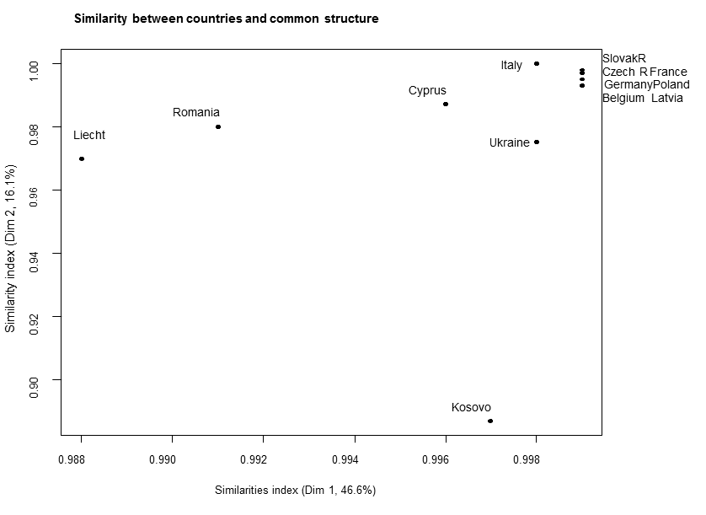
Similarity of ESPAD countries (2011): multigroup PCA
Legleye, Eslami, Bougeard, 2016

Slide 15
The CAST and the DSM: multiple factor analysis
Communalities and discrepancies between the CAST and the DSM-5
  GPS 2014, n=1351, age 15-64, DSM-5 assessed through M-CIDI
  Multiple factor analysis
    Aims at estimating and showing the communalities between the instruments
    Categorical encoding
    Weighting
    Relations between partial axes of each instrument
CAST and DSM share a first strong dimension
The second common dimension is built exclusively by the CAST
  extreme frequencies of use before midday (C1) and alone (C2), memory problems (C3) and reproaches from friends/family (C4)
(Legleye, 2017)

Slide 16
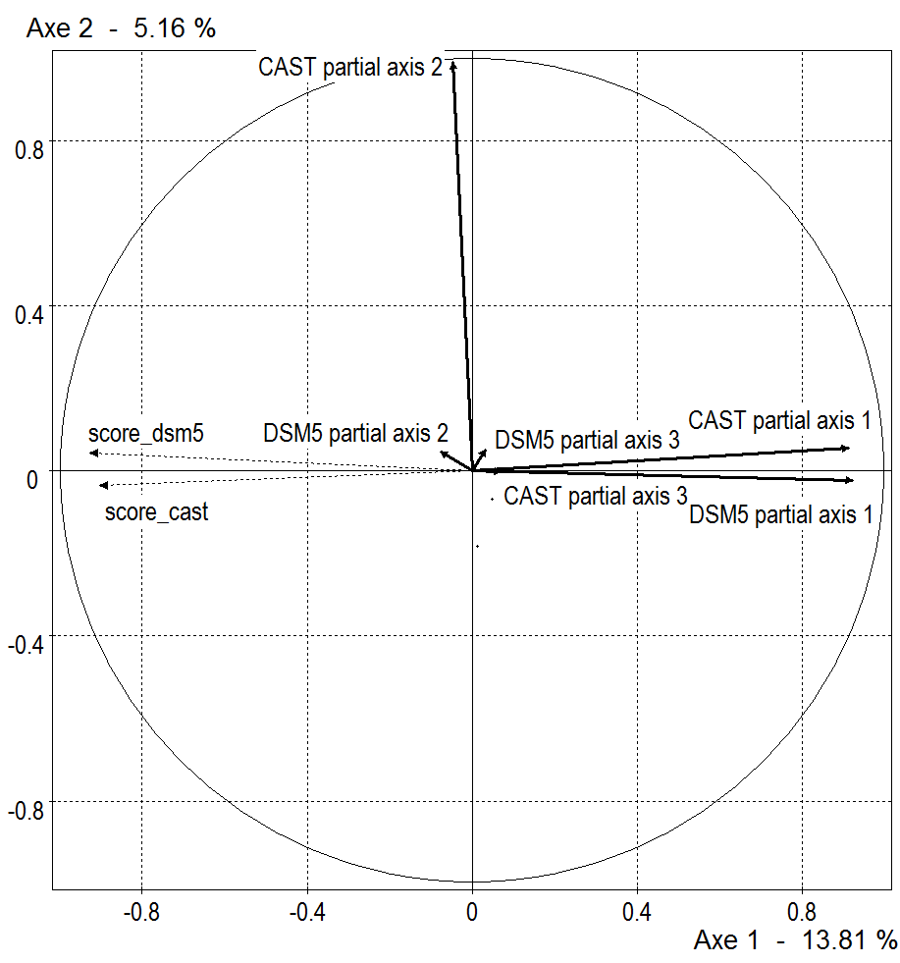
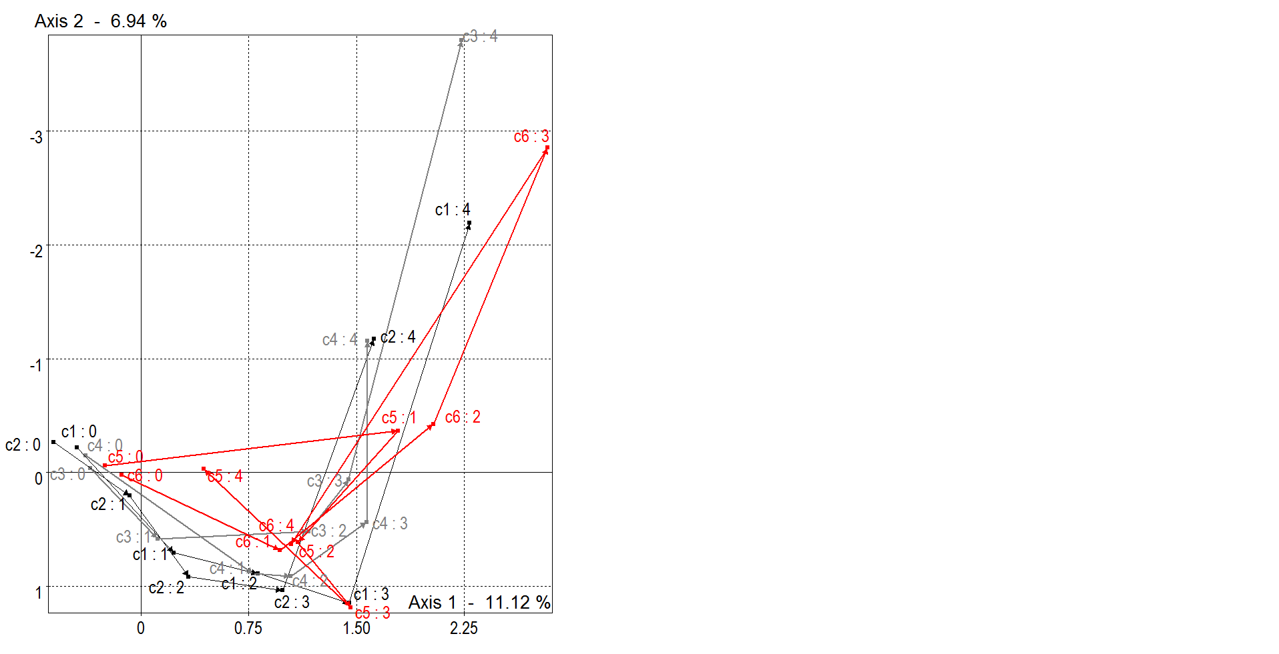
MFA: first factorial plan (partial axes)/ CAST detailed structure

Slide 17
Trends in France (in past-years users)
Adolescents aged 17: trend 2008-2014
  2008: 18% (regular cannabis use: 7,3%)
  2011: 18% (regular cannabis use: 6,5%)
  2014: 22% (regular cannabis use: 9,2%)
General population (15-64 years old): trend 2010-2014
  2010: 21% (past-year cannabis use: 8%)
  2014: 21% (past-year cannabis use: 11%)

Slide 18
Synthesis (1)
The CAST first dimension is very well correlated with DSM-5
The CAST has a secondary dimension that is almost orthogonal to the DSM-5
It has good psychometric and screening properties
  High sensitivity and specificity against the DSM-5
  Screens for a broader spectrum of patterns of use than the DSM-5
The CAST score is correlated with many psychosocial problems in adolescents (Bastiani et al. 2017)
The CAST is not perfect but is the most studied short test screening for problematic use of cannabis

Slide 19
Synthesis (2)
Age-invariance is good but not for C2 (smoking alone): clear effect of age on this pattern of use
What has to be done:
Further study of the extreme responses, optimal rating of the responses
Proper assessment of gender-invariance
Proper assessment of cross-national invariance in European countries
Use in longitudinal studies
  Predictive power of CAST scores for DSM-5 diagnoses in longitudinal studies
Comparisons of assessments and scores at the European level

Slide 20
References (1)
Annaheim and Legleye, 2017: “Short Instruments to Screen for ‘Problematic’ Cannabis Use in General Population Surveys.” In Handbook of Cannabis and Related Pathologies. Biology, Pharmacology, Diagnosis and Treatment, Academic Press, e168–84. Preedy, Victor R.
Asbridge, M., Duff, C., Marsh, D. C., & Erickson, P. G. (2014). Problems with the identification of 'problematic' cannabis use: examining the issues of frequency, quantity, and drug use environment. Eur Addict Res, 20(5), 254-267.
Bastiani, L. Potente R., Scalese M. , Siciliano V. , Fortunato L. , Molinaro S., 2017 “The Cannabis Abuse Screening Test (CAST) and Its Applications”, In Handbook of Cannabis and Related Pathologies. Biology, Pharmacology, Diagnosis and Treatment, Academic Press, 971-980
Beck F, Legleye S. 2008. "Measuring cannabis related problems and dependence at the population level" in A Cannabis reader: Global issues and local experiences, p 29-57 (Vol. 2) Lisbon, EMCDDA.
Legleye, S., D. Piontek, and L. Kraus. 2011. “Psychometric Properties of the Cannabis Abuse Screening Test (CAST) in a French Sample of Adolescents.” Drug Alcohol Depend 113 (2–3): 229–35.
Legleye, S., Kraus L., Piontek D., Phan, O., Jouanne C. 2012, Validation of the Cannabis abuse screening test in a sample of inpatients, European addiction research, 18:193-200
Legleye, S., D. Piontek, L. Kraus, E. Morand, and B. Falissard. 2013. “A Validation of the Cannabis Abuse Screening Test (CAST) Using a Latent Class Analysis of the DSM-IV among Adolescents.” Int J Methods Psychiatr Res 22 (1): 16–26.
Legleye, S., R. Guignard, J.B. Richard, K. Ludwig, A. Pabst, and F. Beck. 2015. “Properties of the Cannabis Abuse Screening Test (CAST) in the General Population.” Int J Methods Psychiatr Res 24 (2): 170–83.

Slide 21
References (2)
Legleye, S., Eslami A., Bougeard S. 2016, Assessing the structure of the CAST (Cannabis Abuse Screening Test) in 13 European countries using multigroup analyses, Int J Methods Psychiatr Res 26(1)
Legleye, S, 2017, The Cannabis abuse screening test and the DSM-5 in the general population: optimal thresholds and underlying common structure using multiple factor analysis, Int J Methods Psychiatr Res (to be published)
Newton, A. S., Gokiert, R., Mabood, N., Ata, N., Dong, K., Ali, S., Vandermeer, B., Tjosvold, L., Hartling, L., & Wild, T. C. (2011). Instruments to detect alcohol and other drug misuse in the emergency department: a systematic review. Pediatrics, 128(1), e180-192.
Rehm, J., Marmet, S., Anderson, P., Gual, A., Kraus, L., Nutt, D. J., Room, R., Samokhvalov, A. V., Scafato, E., Trapencieris, M., Wiers, R. W., & Gmel, G. (2013). Defining substance use disorders: do we really need more than heavy use? Alcohol Alcohol, 48(6), 633-640.
Piontek, D., L. Kraus, and D. Klempova. 2008. “Short Scales to Assess Cannabis-Related Problems: A Review of Psychometric Properties.” Subst Abuse Treat Prev Policy 3: 25.
Piontek, D., L. Kraus, S. Legleye, and G. Buhringer. 2011. “The Validity of DSM-IV Cannabis Abuse and Dependence Criteria in Adolescents and the Value of Additional Cannabis Use Indicators.” Addiction 106 (6): 1137–45.
Sznitman, Rödner S. 2016. “The Cannabis Abuse Screening Test (CAST) Revisited: Examining Measurement Invariance by Age.” Int J Methods Psychiatr Res, October. doi:10.1002/mpr.1529.

